Slide 1

2020 IRP
Scenarios and Modeling Plan
February 27, 2020

Slide 2
IRP Analysis: Process Overview
MODELING
Resource Screening
Initial Portfolio Study
Reliability Screening
Final Portfolio Study
Sensitivity Analysis
Assumptions & Scenarios
Operability Screening
POST-MODELING
Long-term Strategy
Extract findings (observations and conclusions) in order to develop:
Roadmap
Near-term Action Plan

Slide 3
Portfolio Study Scenario Development Approach
Portfolios (“Resource Plans”) Optimal plans based on each scenario and driver combo
A1 | A2 | A3
B1 | B2 | B3
C1 | C2 | C3
D1 | D2 | D3
Scenarios (“Possible Futures”) Based on Major Uncertainties
Scenario A
Scenario B
Scenario C
Scenario D
Drivers (“Influencing Factors”)
Driver 1
Driver 2
Driver 3
X
Variations such as resource costs or focus on specific resource types (e.g. DERs)
Variations likely focused on coal closure timing, electricity load and carbon emission reduction levels
Sensitivity Analysis
(“Impact Testing”)
A1
Sensitivity 1, 2…
B3
Test the impact of changes in key assumptions on the cost of the plan

Slide 4
Key Policy Drivers
  Greenhouse Gas Emissions by Electricity Sector

Slide 5
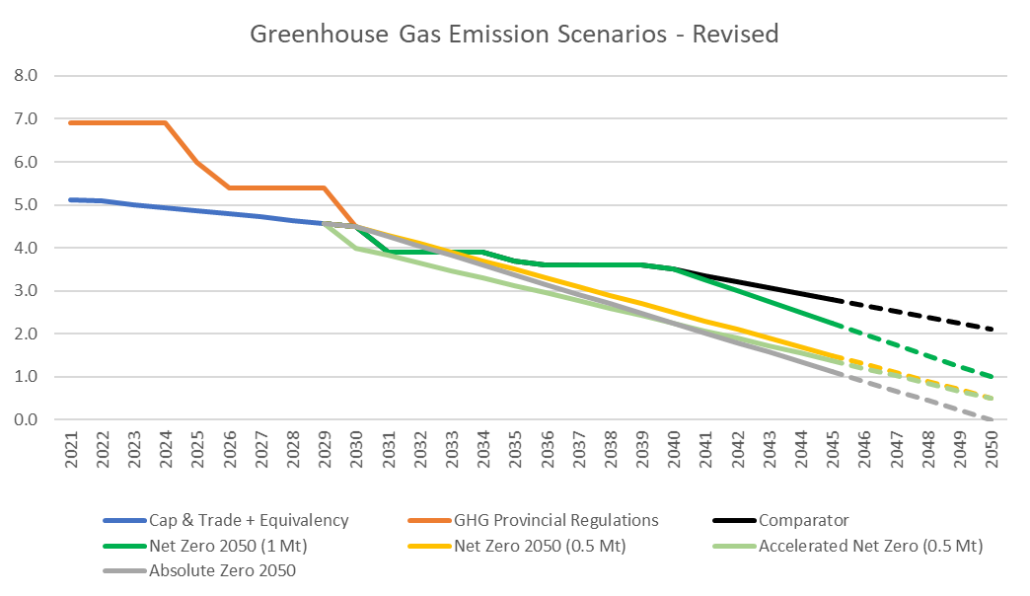
Key Policy Drivers
  Greenhouse Gas Emissions by Electricity Sector

Slide 6
Key Policy Drivers
  Load Changes
  Coal Closure Policy
Business as Usual
2019 Load Forecast
Moderate Electrification
Moderate Space and Water Heating
Moderate EV
High Electrification
High Space & Water Heating
High EV
All Units Retired 2030
Adherence to Federal Regulations
All Units Retired 2040
Ongoing Equivalency Agreements
Applied DSM Scenarios

Slide 7
Key Scenarios
 | 2050 GHG (MT) | Load Driver | Coal Closure
Comparator Case | 2.1 | BAU | 2040
Net Zero – High Electrification | 1.0 | High Elec. | 2040
Net Zero – Moderate Electrification (with Early Coal Closure) | 0.5 | Moderate Elec. | 2030
Net Zero – Moderate Electrification | 0.5 | Moderate Elec. | 2040
Absolute Zero World | 0 | Moderate Elec. | 2030
Additional scenarios of interest to screen using RESOLVE include:
Accelerated 0.5 Mt 2050 / Moderate Electrification / Coal End 2030
Net Zero – 1 Mt 2050 / High Electrification / Coal End 2030
Net Zero – 0.5 Mt 2050/ Business as Usual / Coal End 2040
Net Zero – 0.5 Mt 2050 / Moderate Electrification / Coal End 2030

Slide 8
Resource Strategies
Current Landscape
New In-Province Resources (Supply & Demand)
No new Interconnections
Distributed Resources Promoted
Distributed supply and demand resources are preferred where possible
DER are prioritized in the resource screening stage
Regional Integration
New In-Province Resources (Supply & Demand)
New Inter-connections and corresponding access to energy and capacity
No New Emitting Resources
New in-province and imported supply and demand resources must be non-emitting
    Designed to ensure the IRP analysis covers key areas of importance / interest
    Serve to promote or limit certain resource options to allow them to be evaluated

Slide 9
Key Pairs: Scenarios & Strategies
Scenario | Resource Strategy
Comparator Case | Current Landscape
Net Zero – High Electrification | Current Landscape
Net Zero – High Electrification | Distributed Resources Promoted
Net Zero – High Electrification | Regional Integration
Net Zero – Moderate Electrification | Current Landscape
Net Zero – Moderate Electrification | Distributed Resources Promoted
Net Zero – Moderate Electrification | Regional Integration
Net Zero – Moderate Electrification w/ ECC | Regional Integration
Absolute Zero World | Regional Integration
Absolute Zero World | No New Emitting Resources
    These pairs represent the proposed ten preliminary modeling runs to be conducted in Plexos LT in the Initial Portfolio Study Phase
    Additional combinations of scenarios and strategies can be tested using E3’s RESOLVE model to assess if they should be included as a key modeling run

Slide 10
Sensitivity Analysis
Increase in Renewable Energy Standard policy
Low capital cost of wind
Low capital cost of storage
Low pricing of import energy
High pricing of import energy
High pricing of natural gas
Carbon tax/pricing
Fuel security sensitivities
Resiliency testing
    Run against a resource portfolio to determine how it responds to changes in assumptions
    Prioritized with Stakeholders based on emerging insights from the ongoing analysis

Slide 11
Proposed Evaluation Criteria
Metric | Description
Minimization of the cumulative present value of the annual revenue requirements over the planning horizon (adjusted for end-effects) | 25 year NPV Revenue Requirement
Magnitude and timing of electricity rate effects | 10 year NPV Revenue Requirement
Reliability requirements for supply adequacy | Evaluation of PRM, resource capacity adequacy, operating reserve requirements, etc.
Provision of essential grid services for system stability and reliability | Quantitative and qualitative assessment of the status of essential grid services provision for each portfolio.
Plan robustness (the ability of a plan to withstand plausible potential changes to key assumptions) | Magnitude of the plan’s exposure to changes in key assumptions (via sensitivity analysis)
Reduction of greenhouse gas and/or other emissions | Mt of CO2 reduced over 25 years
Flexibility (limitation of constraints on future decisions arising from the selection of a particular path) | Qualitative assessment of timing of investments

